Slide 2
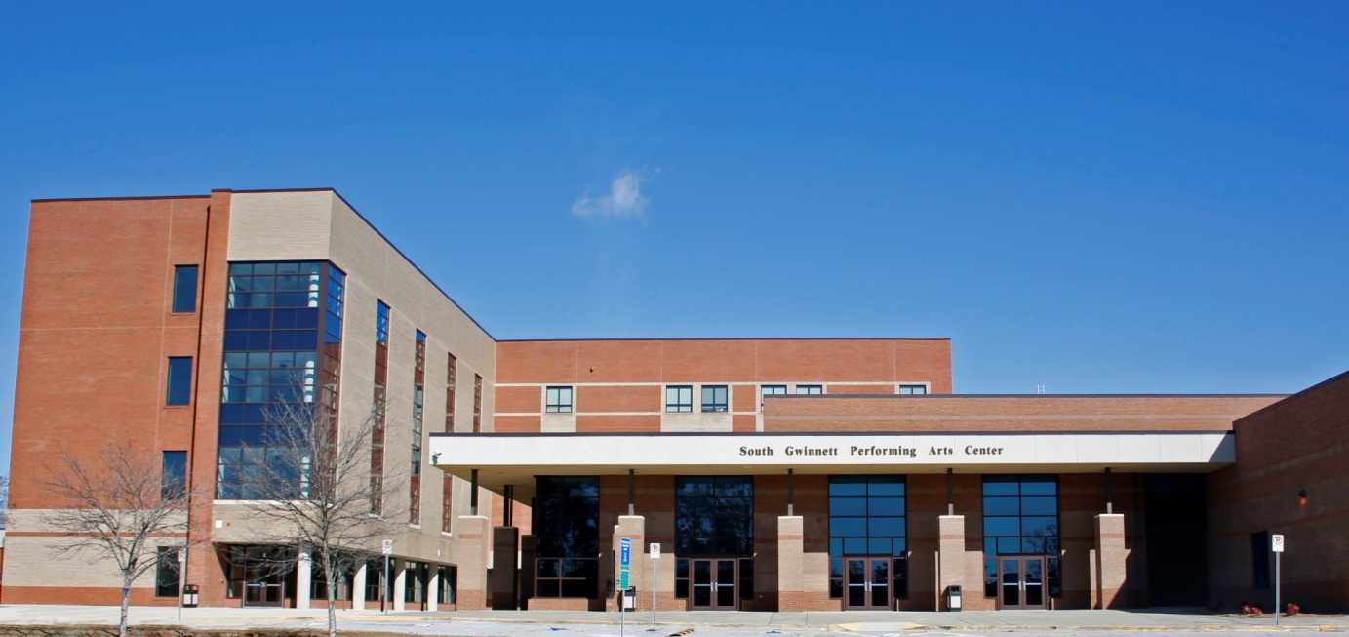
COLLEGE & CAREER CENTER
WELCOME
SOUTH GWINNETT HIGH SCHOOL
CLASS OF 2023 & 2024

Slide 3
COLLEGE & CAREER CENTER
Location: A119
Kennard M. Weever
Career Academy Specialist
678-344-3080 kennard.weever@gcpsk12.org

Slide 5
START strong
Opportunities & Options

Slide 6
College/Career Portfolio
What is a Portfolio?
A portfolio is a collection of accomplishments and work in an area of talent/interest you have pursued or are pursuing. The collection might include:
Artwork: drawing, painting, photography, graphic art
Musical composition: scores, song lyrics, arrangements
Writing: novels; screenplays; poetry; history; news articles; scientific research, both published and unpublished
Performance art: vocals – choral, solo, scat; musical – bands, orchestras, paid gigs, solos; and theatrical – theater, comedy, storytelling
ACT/SAT Scores if you have them
Notes:
Portfolio: portfolio should include activities where talents, leadership, and skills shine. Whether the focus is art, dance, drama, music, sport, or other activities
Adherence to the requirements of the college/university
Once you've identified a school or specific program that interests you, the next step is understanding its portfolio requirements.
Multiple mediums and techniques.
Finished work, projects, writing abstracts

Slide 7
GRADUATION REQUIREMENT & UPDATES

Slide 8
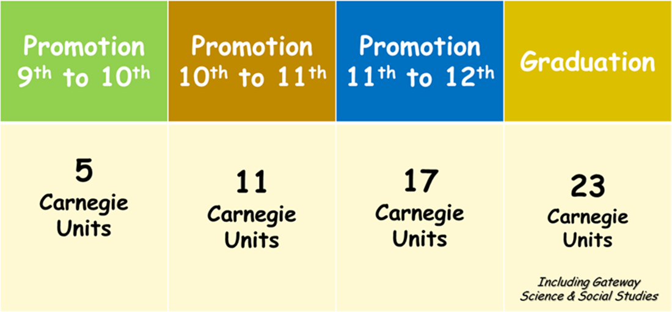

Slide 9
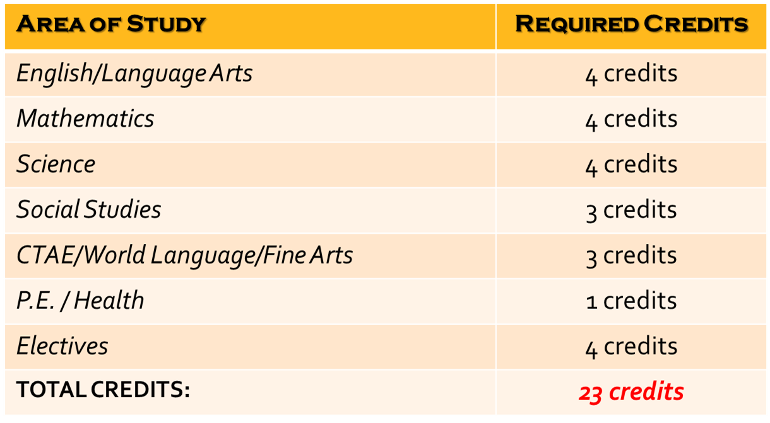

Slide 10
Personal essay
Begin With the End in Mind

Slide 11
MANAGING THE PROCESS
Time Management is key!
ACT & SAT (Prep Sessions – Khan Academy), ASVAB & ACUPLACER, SCORES REPORTING
Counselor & Teacher Recommendations (allow 2 weeks notice)
Transcripts (Free through GA Futures in state. Mypayments plus for out of state)
Maximize Your Local School Resources
Counselors, Core Teachers, College & Career Center, Parents & Family)
SGHS Counseling Department Website

Slide 12
CREATE ACCOUNTS FOR:
WWW.GAFUTURES.ORG
WWW.COMMONAPP.ORG
NAVIANCE
WWW.COLLEGEBOARD.COM
WWW.FASTWEB.COM
WWW.STUDENTSCHOLARSHIPS.ORG
WWW.GOINGMERRY.COM

Slide 13
FINANCIAL AID PLANNING

Slide 14
Fafsa completion

Slide 15
Time to FAFSA
APPLICATION OPENED
October 1, 2022
For Class of 2023

Slide 16
scholarships

Slide 17
CREATE ACCOUNTS FOR:
WWW.FASTWEB.COM
WWW.STUDENTSCHOLARSHIPS.ORG
WWW.COLLEGEBOARD.COM
WWW.GOMERRY.COM
CAPEX.COM
UNIGO.COM
FINAID.ORG
BOLD.ORG
GCPS-FOUNDATION.ORG

Slide 18
College applications

Slide 19
FLY-IN PROGRAMS
Many Colleges/Universities Offer Options

Slide 20
EARLY APPLICATIONS EARLY DECISIONS
DEADLINES
ARE DEADLINES

Slide 21
PARTNERSHIP WITH -Georgia Gwinnett College

Slide 22
Final transcripts

Slide 23
ANNOUNCEMENTS

Slide 24
Senior and Junior College Fair November 10, 2022

Slide 25
QUESTIONS – COMMENTS - CONCERNS

Slide 26
COLLEGE & CAREER CENTER
Location A:119
Kennard M. Weever
Career Academy Specialist
678-344-3080 kennard.weever@gcpsk12.org

